Slide 1
Интегрированный урок Английский язык и ОБЖ по теме «Здоровый образ жизни»
из опыта работы учителя
английского языка
МОУ « Основная школа №8»
Кануник И.В.

Slide 2
Цели урока:
1.Создание информационного пособия «Здоровый образ жизни».
2. Реализация творческого потенциала учащихся как субъекта самостоятельной учебной деятельности.
3.Актуализация личностно-значимых мотивов
учебной деятельности.
4.Интеграция межпредметных знаний.

Slide 3
☺
☹
Eating a lot of fruit
Самолечение, диеты
Doing exercises
Вредные привычки
Healthy
lifestyle
Социальная агрессия
Training
Нарушение экологического равновесия
Airing the room
Sleeping 8 hours a day
Производственный фактор

Slide 4
1 Жить не для того, чтобы есть, а есть для того чтобы жить
a) Early to bed and early to rise makes a man healthy wealthy and wise
1 Жить, чтобы жить, для того, чтобы, есть, не для того, чтобы есть, а
2 Кто рано ложиться и рано встает, здоровье, богатство и ум наживет
b) Money can buy a tonic, but not health
2 Здоровье, и, рано, ложиться, встает, наживет, кто, ум, и, богатство, рано
3 Здоровье за деньги не купишь
c) Live not to eat but eat to live
3 Купишь, не, деньги, за, здоровье

Slide 5
Healthy food products for you

Slide 6
Vegetables

Slide 7
Carrot
Carrot has a lot of vitamin A, so it is good for your eyes and it helps to grow.

Slide 8
Tomato
Tomato is very useful for your heart ; blood. It helps your stomach and intestines to work better and strengthen your organism.

Slide 9
Onion and garlic
Are rich in special substances which prevent you from colds and many other diseases.

Slide 10
Fruits

Slide 11
Lemon
Lemon is full of vitamin C and it prevents from colds.

Slide 12
Kiwi
Kiwi is a source of vitamins A;B;C and cellulose and magnesium. It improves your immunity, digestion. It is healthy for your blood and vessels, reduce cholesterol.

Slide 13
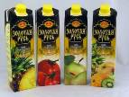
Drinks

Slide 14
Green tea
Is highly useful for us first of all it has a of antioxidants and helps to be younger and healthier. It is very good during a hot summer and it strengthens your organism.

Slide 15
Natural juices
They have a lot of vitamins. Juices can freshen you, make you strong and healthy and they are simply very tasty.

Slide 16
З
- зрение, закаливание, забота
– honey, heart
H
E
– eyes, exercises
Д
- доброта, дружба, диета
A
– air the room, apple
О
- осанка, отдых
L
– lettuce, lemons
Р
- работоспособность, режим
T
– teeth, take a warm bath
О
- обливание, обтирание
H
В
– 8 hours sleeping, herb tea
- водные процедуры, выносливость
Ь
Е
- единство требований, естественная среда

Slide 17
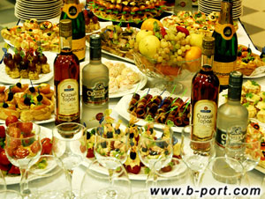
Useless or harmful food products

Slide 18
Sausage
Sausage, especially smoked, is harmful for you. It’s high in cholesterol and calories. Usually, there are different additions bad for stomach and nitrates. People with chronic lung and gastric diseases should avoid this food

Slide 19
Fried and smoked meat
It’s full of cholesterol, carcinogens and fat especially pork. You should eat it very carefully if you have blood pressure, obesity, sore liver, diabetes, heart diseases.

Slide 20
Potato crisps
They are high in fat, carcinogens, salt, additions (often spicy) and calories. They cause gastric problems and obesity.

Slide 21
Sweets
There is a lot of sugar in this food and when you eat it much, it ruins your teeth. As this products have a great number of carbohydrates and calories, they can lead you to obesity. Ice-cream also can affect your throat and stomach.

Slide 22
Fizzy drink
These drinks are absolutely bad for you. No one useful component, but a lot of gas, coloring matters and sugar. Coke can affect your child-birth organs.

Slide 23
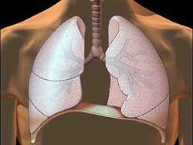
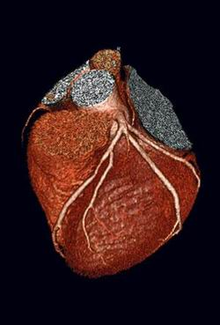
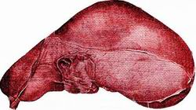
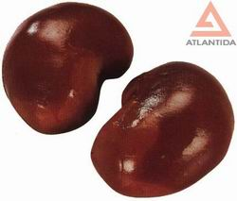
sweets
meat tins
sausage
butter
concentrated
juices

Slide 24
Useful and healthy habits

Slide 25
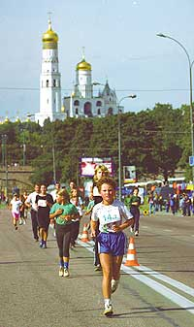
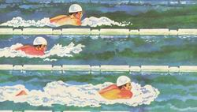
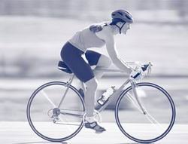
Going in for sport
It is very useful for us. Nowadays our life is too dynamic and nervous and so sport helps to relax. For example, jogging is good for your heart, swimming is good for your arms, cycling is good for your legs and so on.

Slide 26
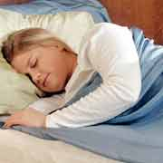
Healthy sleep
It’s the best way of rest. You should sleep not less than 8 hours a day. Go to bed and wake up at the same time even at weekends. There are a lot of ways which can help you to sleep, one of them is to drink a cup of hot milk and honey.

Slide 27
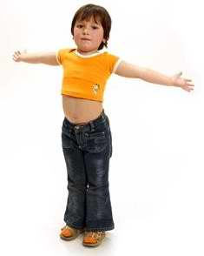
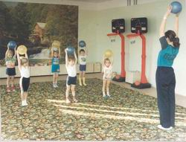
Morning exercises
If you have no time to take up sport regularly morning exercises are just for you. It helps you to keep your fitness and to be in a good form.

Slide 28
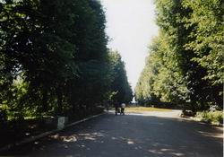
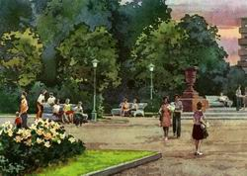
Walking
Helps you to relax, to loose your weight, to breath the fresh air. You have time not to be hurry, to think, to talk. It’s very healthy to do it after dinner and before going to bed.

Slide 29
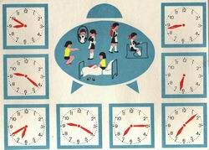
Keeping of a day regime
Makes your life more regular. It helps you to organize yourself. You have more time for rest and leisure activities. It makes you healthier because you have more time for sleeping either. Especially you need it during your exams.

Slide 30
1) депрессия, чувство вины, безысходность, обиды 2) swimming, cycling, jogging 3) употребление алкоголя и наркотических веществ, , нестабильность политической обстановки, нагнетание страха 4) black currants, herb tea, vitamins, brown bread,
оптимизм,
hypo dynamics,
счастье,
сakes.

Slide 31
Part 1
The duration of life in ancient Greece was ….. years in the fourth century BC
In …. century…... 20 – 35 years
In 1850 - ….. years
In ….. – 50 years
In 1960 - …..years
In ….. – 73 years
Part 2

Slide 32
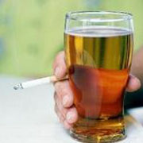
Bad and Harmful Habits

Slide 33
Drinking alcohol
is absolutely harmful for you. It is a disease which ruins not only your organism, but your personality too. It affects your health, first of all your liver. Beer is also alcoholic drink and the result will be the same as from wine, vodka and etc.

Slide 34
Smoking
is widely spread nowadays. Many people smoke without thinking about themselves and about people near them, especially children. Smoking damages your health: such organs as lungs, bronchial, tubes, heart and others. Stop smoking today or it will be late.

Slide 35
Working on a computer, watching TV
When you do it one or two hours it’s not bad. You can get a lot of new information, it helps to do you homework etc. But when it’s too much it damages you. First of all it ‘s bad for your eyes, brains, nerves system. Other result your sight becomes worth, you can’t sleep well and so on.

Slide 36
Inactive way of life
You forget to do exercises every morning, you do not go in for sport, you go by car or transport instead of working. It means you ruin your health, your muscles don’t work, your weight become more and more, your sleep is bad. Stop do it and start to move.

Slide 37
Mobile phones
it’s very convenient to be connected everywhere and every minute. But it’s known that mobiles can be harmful because electric waves which make bad influences on your health. Especially it dangerous to use mobiles in an underground and tunnels. In order to find their stations mobiles increases the amount of the waves. Try not to spend all days long with your mobiles.

Slide 38
1. Do you always wash your hands after coming home from outside, after visiting a toilet, before eating? | Yes, I do. No, I don’t.
2. Do you use any sugar free chewing gum after eating? | Always Never
3. Do you often eat vegetables and fruit? | Regularly Seldom
4. Do you keep the regime of nutrition? | Always No, I don’t.

Slide 39
1. It’s known that our health depends about 50% on:
A Healthy way of life
B Ecology
C Heredity
D Medical service
2. Choose from the enumerated points what can be related to a healthy way of life only: 1) absence of bad habits; 2) active way of life; 3) psycho hygiene; 4) the ability to control your emotions; 5) competent ecological behavior
A 1; 2; 3; 5
B 1; 2; 3
C 1; 2; 3; 4; 5
D 1; 4; 5
3. What is hypo-dynamics? (hypo-actions)
A surplus of actions (movement)
B lack of actions
C the same actions
D different actions
4. What percentage of your group doesn’t do morning exercise?
5. What food should be eaten oftener to strengthen your teeth?
A food high in vegetable and animal fat
B meat food
C fish and seafood
D apples, carrot, nuts, cheese, olives

Slide 40
1. Считается, что здоровье человека на 50% зависит от:
А) здорового образа жизни;
Б) экологии;
В) наследственности;
Г) медицинского обслуживания.
2. Из перечисленного: 1) отсутствие вредных привычек; 2) активный образ жизни; 3) психогигиена; 4) умение управлять своими эмоциями; 5) грамотное экологическое поведение – к здоровому образу жизни относится только
А) 1,2,3,5;
Б) 1,2,3;
В)1,2,3,4,5;
Г)1,4,5.
3.Что собой представляет гиподинамия?
А) избыток движения;
Б) недостаток движения;
В) однородное движение;
Г) разнообразные движения.
4. Какой процент учеников вашей группы не делает утреннюю гимнастику?
5.Какую пищу необходимо чаще употреблять, чтобы укрепить зубы?
А) продукты, содержащие животные и растительные жиры;
Б) мясные продукты;
В) рыбу и морепродукты;
Г) яблоки, морковь, орехи, сыр, оливки.

