Slide 1
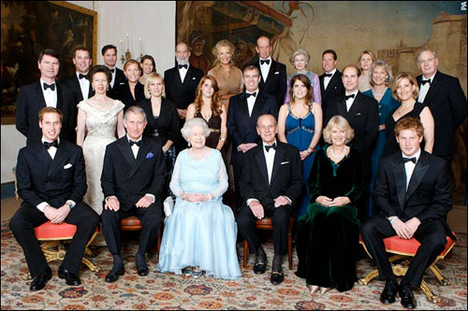
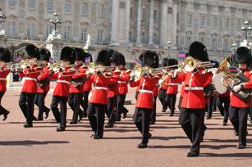
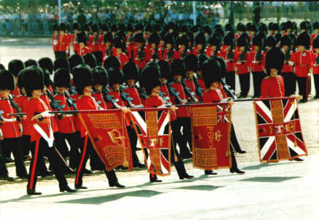
English traditions and customs.
The presentation is made by the students of 11A Form Tarasov Maxim, Arsenyan Marina and by the student of 9C Form Rusakova Marina.
Teachers: Pukhteeva Valentina Nikolaevna,
Kozlova Ludmila Valentinovna.

Slide 2
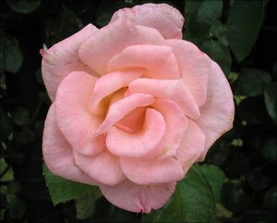
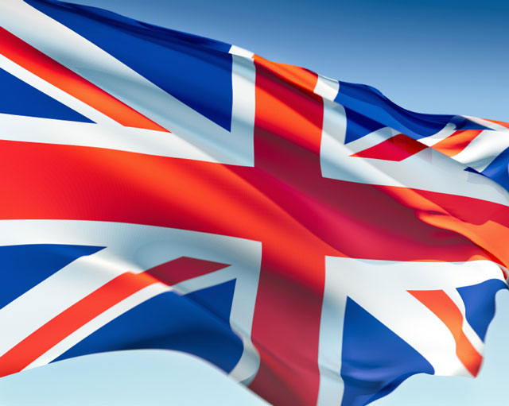
So many countries so many customs…
English traditions…
In fact, England is impossible without its traditions. This is inevitable factor of social and private life of the British Isle`s population, accompanying each Englishman all his life from birth to death.
But everything is changing. English traditions and the attitude of English people to them are changing too.
Back

Slide 3
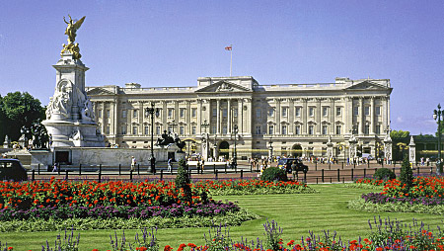
Royal Traditions.
London has still preserved its old ceremonies and traditions to a greater extent than any other city in England.
Back

Slide 4
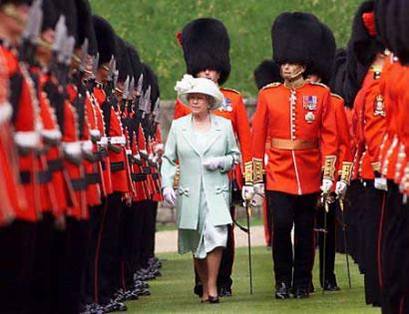
CHANGING THE GUARD.
One of the most impressive and popular displays of royal pageantry is Changing the Guard; which takes place at Buckingham Palace every day, including Sunday, at 11. 30.
Back

Slide 5
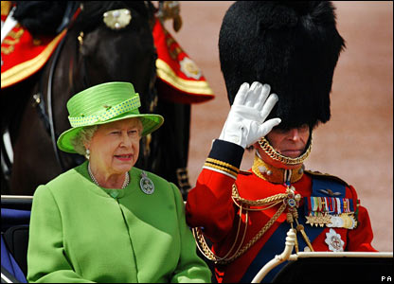
MOUNTING THE GUARD.
The colourful spectacle of Mounting the Guard, at the Horse Guards, in Whitehall, always attracts London sight­seers.
It can be seen at 11a. m. every weekday and at 10 a. m. on Sundays.
Back

Slide 6
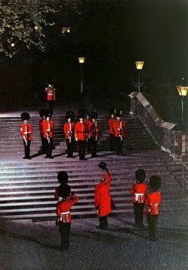
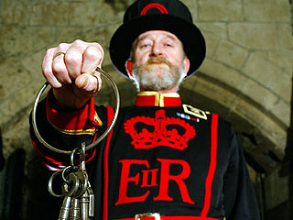
THE CEREMONY OF THE KEYS.
Every night at 9.53 p. m. the Chief Warder of the Yeomen Warders (Beefeaters) of the Tower of London lights a candle lantern and then makes his way towards the Bloody Tower.
Back

Slide 7
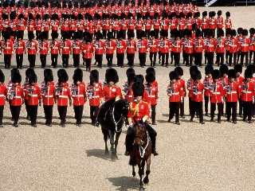
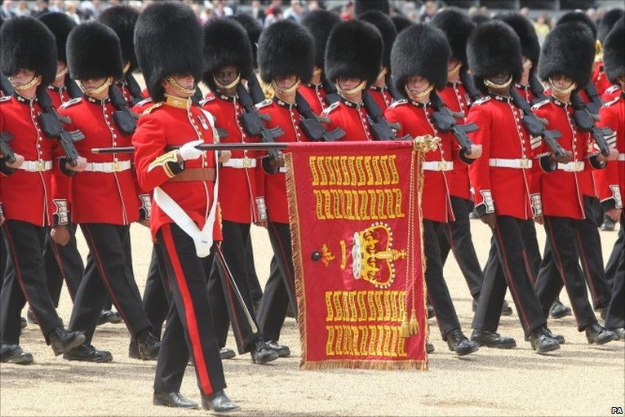
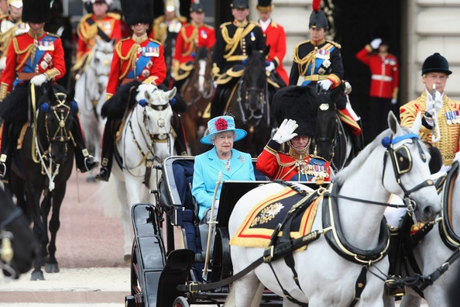
TROOPING THE COLOUR.
Back

Slide 8
Видео.
Back

Slide 9
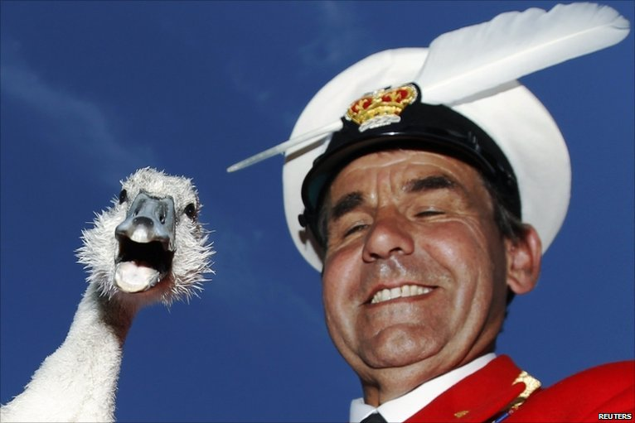
SWAN UPPING.
Once a year, usually in the second half of July, the ceremony of Swan-Upping and Marking is performed from gaily flagged skiffs by the Queen's Swanmaster and the Swanmasters of the Dyers and Vintners.
Back

Slide 10
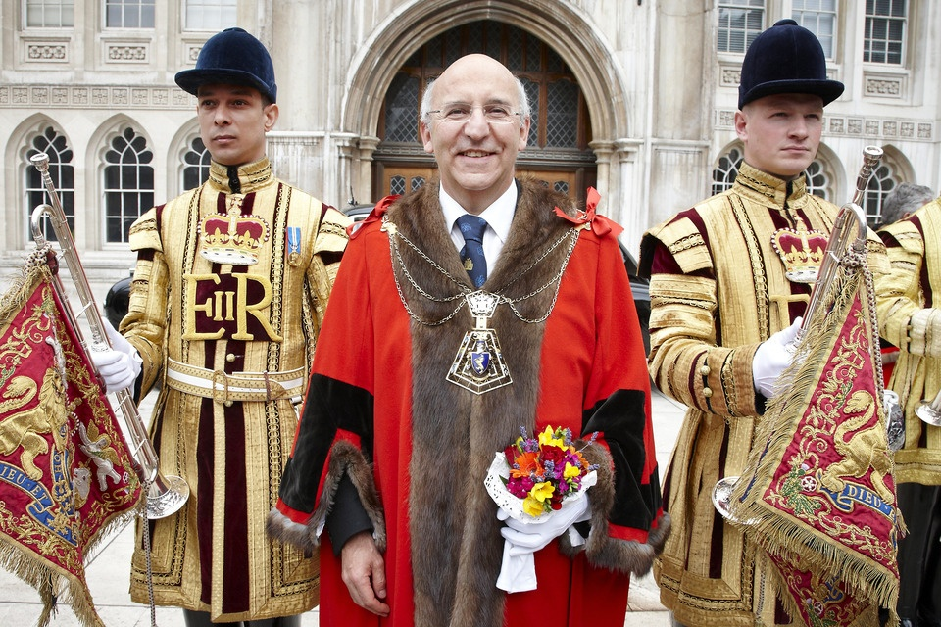
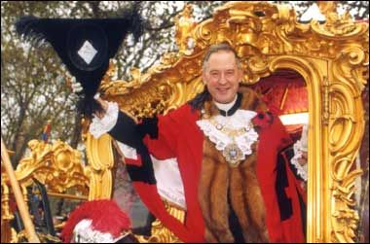
ELECTING LONDON'S LORD MAYOR.
One of the most important functions of the City's eighty-four Livery Companies is the election of London's Lord Mayor at the Guildhall at 12 noon on Michaelmas Day (September 29th).
Back

Slide 11
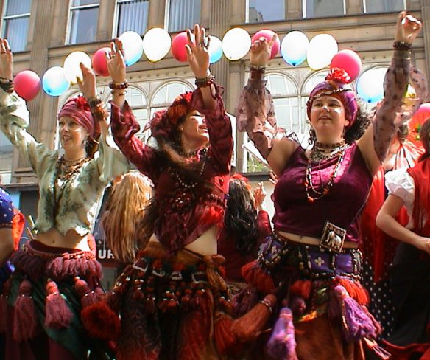
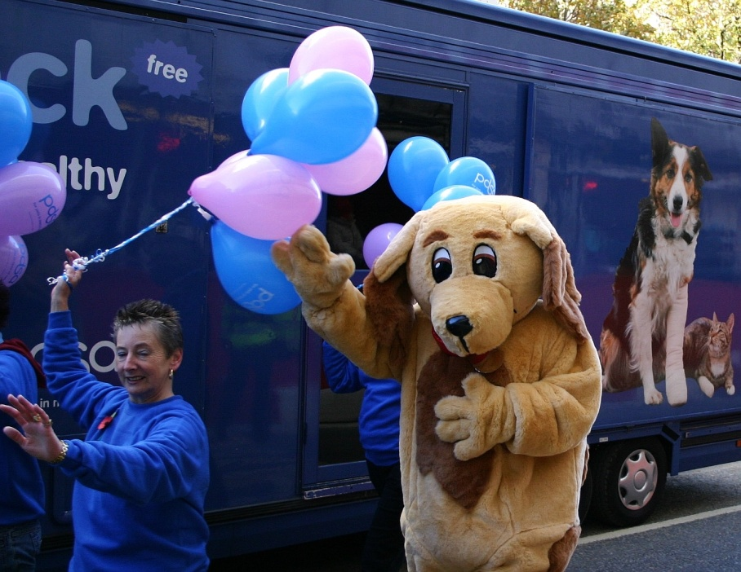
THE LORD MAYOR'S SHOW.
The splendid civic event known as the Lord Mayor's Show is watched by many thousands of people, who throng the streets of the City of London on the second Saturday of November to see its interesting procession and admire its glittering pageantry.
Back

Slide 12
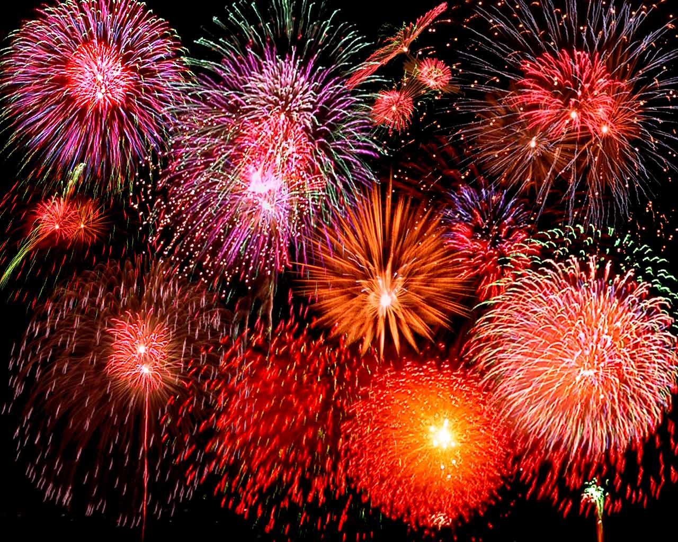
Thank you for your attention!

